Slide 2
Mission
Inspire and support young people in starting successful businesses.

Slide 3
History
Founded in 2009 by five fellow students at the Sofia University “St. Kliment Ohridski”

Slide 4
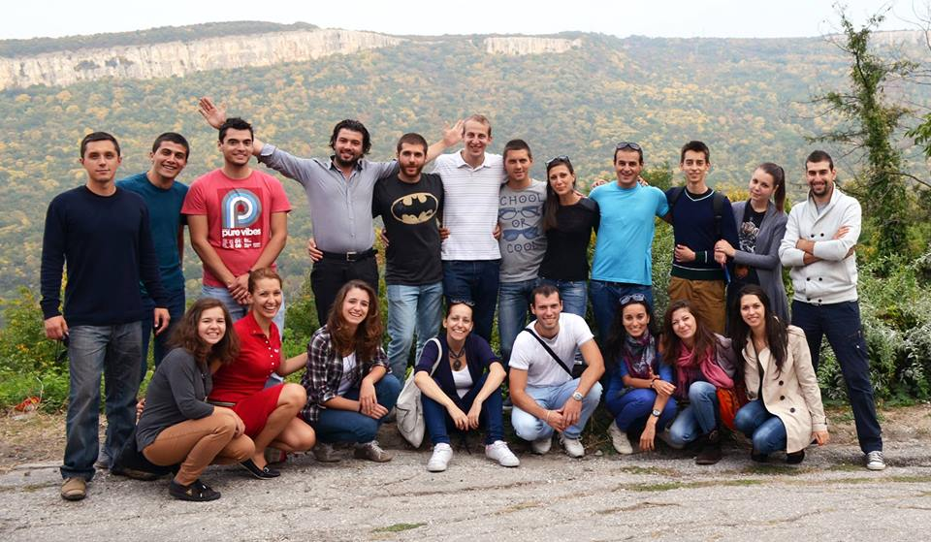
About Us
The core team consists from 20 people

Slide 5
Our network
More than 50 mentors
6500+ FB fans
4500+ people subscribed for our newsletter
First local club founded in Ruse in February 2013, two more in process

Slide 6
Projects

Slide 7
European Enterprise Promotion Awards

Slide 8
Contacts
mila.grigorova@startitsmart.com

