Slide 1
VMware: An Overview
Pat Gelsinger, CEO
Notes:
VMware helps companies around the globe accelerate their move to the new era of IT, commonly referred to as cloud computing.
However, we do not believe in a one-size fits all strategy. We believe your business is unique, and thus your approach to cloud computing will be as well.
This is what differentiates VMware, and ultimately, what will differentiate you in your business.

Slide 2












VMware Overview
Company
  >$4B in revenue in 2011
  >$5B in cash equivalents and short-term investments
  ~13,000 employees worldwide
    39 offices and 2500+ employees in EMEA
  5th largest infrastructure software
  company in the world
Customers
  400,000+ VMware customers
    176,000 VMware customers in EMEA
  55,000+ VMware partners
  100% of Fortune 100
  100% of Fortune Global 100
  99% of Fortune 1000
  97% of Fortune Global 500
Notes:
(Data is as of Q2F12)
We are uniquely qualified to support customers’ journey to the new era of IT, given our clear leadership in virtualization – the foundation for cloud computing architectures.
Through innovation, and by challenging the status quo, VMware has become central to the IT transformation wave taking place in small to large global enterprises, fueling continual growth and investment in further product development.
Optional stat to add: TM Free Cash Flow of $2B
If above FCF is used, the following would need to be inserted at the beginning of the deck:
This presentation also includes references to certain non-GAAP financial measures. These non-GAAP financial measures should be considered in addition to, and not as a substitute for or in isolation from GAAP measures. Reconciliations to the most directly comparable GAAP financial measures are available on the VMware Investor Relations website.

Slide 3

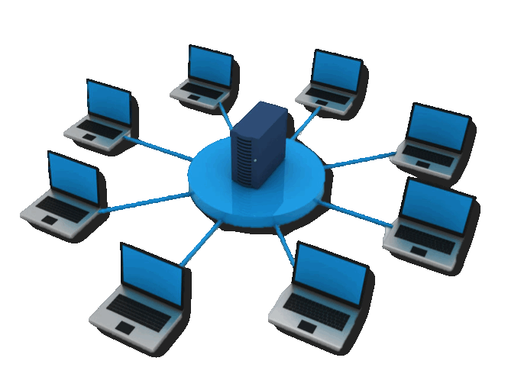
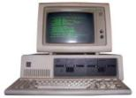


Waves Of Change In IT
Networked/ Distributed
Computing
Cloud
Computing
PC/
Microprocessor
Minicomputer
Mainframe
Notes:
We think cloud is the next wave of massive disruption in IT that started with Mainframes.
It’s disruptive because of the dramatic benefits it delivers to organization in both cost efficiency and agility (bottom line and top line).
Its disruptive because it’s built on disruptive technologies and disruptive technology leads to lasting change.
In the case of cloud, it’s arguably the most disruptive because we are seeing the IT cloud wave and the consumer cloud wave happen simultaneously.

Slide 4

The Impact of Cloud
Mobile
Users
PCs
Access
Existing
Apps
New Apps
& Big Data
Applications
Servers
Infrastructure
Clouds

Slide 5


































Cloud Adoption Trends
Healthcare
Financial Services
Public Sector
Education
Service Providers
Notes:
Healthcare: One of the last major industries moving away from “paper-based” business workflows and data exchanges into a fully digital “connected” ecosystem. The worlds leading Healthcare EMR and imaging companies partner with VMware to extend the reach of patient care: EPIC, GE, Siemens, Cerner and McKesson. Follow me desktops allow caregivers to access critical patient care data/images where the care encounter takes place (ie: In-Patient, office, home or rural locations). Customer story: Johns Hopkins designed a Cloud-based Medical Imaging solution based on VMware technology. They commercialized the technology and company now called Peake Healthcare.
Financial Services: Financial services we're actually largest in Virtual Desktops (many customers over 25k VMs, some over 50k VMs) followed by other parts of infrastructure (including external web services). This is all the largest number of ESX servers and VMs are with Investment Banks, Commercial and Retail Banks, Insurance Companies, etc. Customer story: VMware a built private cloud for NYSE that manages 1/3 of the world wealth. Complex trading operations went from days to minutes. Now have the ability to offer the world’s first public cloud for the financial services industry.
Public Sector/Education: All 50 state governments, thousands of local governments, the federal government and education organizations are increasingly embracing datacenter and desktop virtualization to deliver better value and services to taxpayers and students via the cloud. VMware solutions are broadly used throughout all U.S. cabinet level agencies, all four military services of the Department of Defense, its agencies and joint commands, as well as the Judicial and Legislative branches. (ie: U.S. Navy and Marine Corps and the Departments of Energy, Veterans Affairs and the Centers for Disease Control). Customer stories: Public Sector: Government Computer News article released an article in September 2012 on Centers for Disease Control on how they are using vSphere to reduce costs and accelerate their R&D efforts. Education: Oxford University’s Computing Service (OUCS) needed to administer a secure database-as-a-service (DBaaS) solution to manage and share research data. VMware’s Hybrid Cloud has enabled OUCS to build a DBaaS that is shared by Oxford Colleges and other research universities. A Hybrid Cloud was the only solution able to overcome security restrictions on datasets which require on-premise location. Increased data protection and improved service levels have enhanced their reputation in research excellence and now proven in production. As a result, DBaaS will now be offered as a service to all major UK research universities.
Service Providers: We have the largest partner ecosystem with revenue growth at 185% year over year. We have 9 partners from telecommunications to computer technology and IT service providers. Service Providers enable IT organizations to have choice of how they run their data and apps, while VMware provides a heterogeneous management platform for comprehensive metrics on these workloads running across their private, hybrid, or public environments at any given time. VMware has seen increased demand for these customizable cloud environments, as CIOs prioritize cost and energy reduction in their data centers, a need to deliver more business value, faster, and evolve their legacy applications while still getting the security, flexibility, and availability they expect from their private cloud infrastructure. There are over 150 cloud environments supported by our vCloud Partner Ecosystem (in 29 countries, covering 1.27 million square feet of datacenter space), as we expect to see this increase with other public and hybrid cloud offerings in the industry, as IT looks to have the “best of both worlds”. Customer story: The Japanese tsunami of 2011 and office/datacenter moves created a need for Columbia Sportswear to leverage the hybrid vCloud for their production workloads offsite. Given their portability of workloads moving within the data centers, the company now wanted to take a closer look at the option of moving workloads outside the facility with the least amount of complexity. Columbia Sportswear went from 25% virtual to over 96% virtual using the hybrid cloud today.
More on SP’s: Our breadth of service providers such as AT&T, Bluelock, Dell, OVH, SingTel, T-Systems allow for both enterprise and SMB companies to deliver business value faster while maintaining a secure environment that mirrors internal systems. Four of the five leaders in the Magic Quadrant (Gartner) offer an IaaS based on VMware. vCloud customers such as Columbia Sportswear, Ducati, Lufthansa Systems, AutoScout24, Sega Europe and others have all leveraged cloud to meet their infrastructure demands.

Slide 6
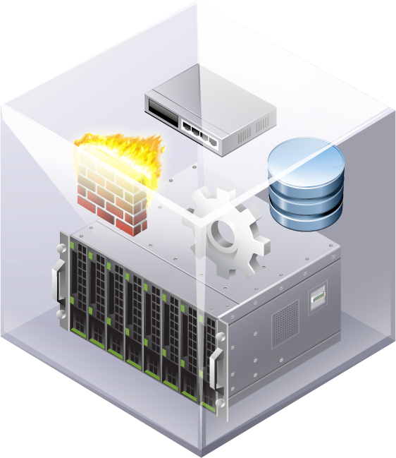
The Vision
Software-Defined
Datacenter
All infrastructure is virtualized and delivered as a service, and the control of this datacenter is entirely automated by software.
Standardized.
Holistic.
Adaptive.
Automated.
Resilient.
Notes:
That is the promise of a new architectural approach to the datacenter.
The software-defined datacenter: All infrastructure is virtualized and delivered as a service, and the control of this datacenter is entirely automated by software.
It’s the direction we have been heading in as an industry in various forms; now it’s time to put it all together into a cohesive approach for the entire datacenter.
The software-defined datacenter includes 5 essential characteristics:
<click> Standardized: Homogenous infrastructure is delivered as software services across pools of standard, x86 hardware, to eliminate unnecessary complexity.
<click> Holistic: A unified platform is optimized for the entire datacenter fabric, providing comprehensive infrastructure services capable of supporting any and all applications.
<click> Adaptive: Self-programmable virtualized infrastructure services are provided on-demand, unconstrained by physical topology, dynamically adapting to application scale and location.
<click> Automated: Built-in intelligence automates provisioning, placement, configuration and control based on defined policies.
<click> Resilient: Software-based architecture and approach compensates for failing hardware, providing failover, redundancy, and fault tolerance to critical operations.

Slide 7


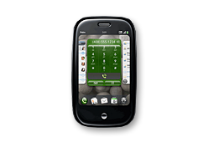

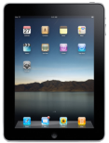
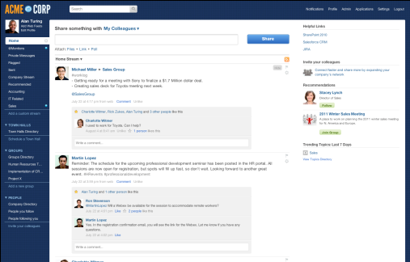
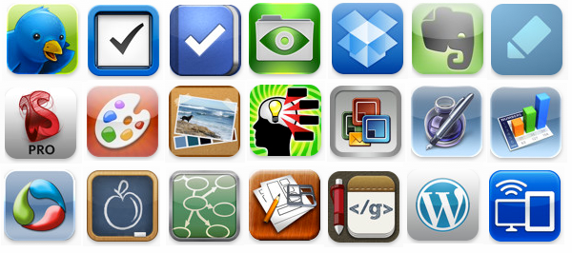
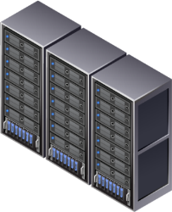
In Summary: VMware’s Strategy
Empowered, Secure Mobile Workforce
Faster
Time-to-Market
for Modern Applications
A More Flexible, Scalable, Efficient Software-defined Datacenter
Existing Datacenters
Public Cloud Services
Notes:
VMware’s strategy is built to support and drive cloud adoption; by delivering both infrastructure and collaborative applications to support a more empowered and productive workforce in the Post-PC era, without compromise to security and compliance.

Slide 8
VMware Bulgaria
Diana Stefanova, Managing Site Director, Bulgaria & EMEA R&D
Notes:
8
Диана Стефанова, Управляващ директор, Центрове за разработка, България & EMEA

Slide 9
Regional update
Why Bulgaria?
Great Talent:
Biggest VMware R&D Center in EMEA
Product Focus: Cloud Management and Automation
Strong customer focus for EMEA
EMEA Market alignment
EU membership, low taxes, good infrastructure
Stable Business Environment:
Huge software market
EMEA Market Alignment:
Hiring not only from BG but from EMEA as well
Notes:
Създаване на решения с висока стойност за клиента. Използване на иновативни подходи в разработката на продукти от следващо поколение за управление на виртуални инфраструктури и автоматизация на процеси.
Като част от мисията: Ефективно позициониране в EMEA и развитие спрямо потенциала и динамиката на този пазар.
9

Slide 10
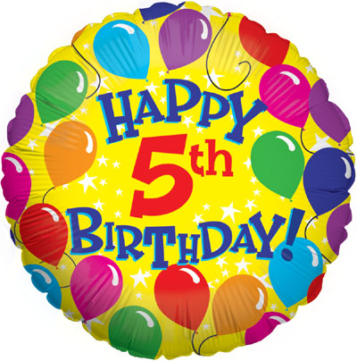
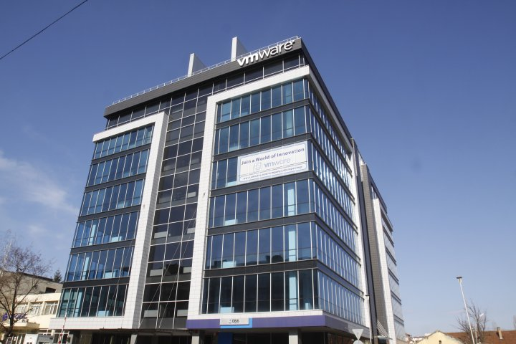
Site Overview
5 Year Anniversary
  Where are we today?
  350 Employees
  ~ 20 % annual growth
  Employer of choice
  Product Focus Cloud management and automation
Notes:
VMware празнува петата годишнина на българския развоен център.
В софийския офис на команията, който е най-големия център за разработки на VMware в EMEA, работят 350 служители.
Среден годишен ръст на екипа около 20 процента.
VMware България като предпочитан избор за кариерно развитие.
Гордеем се с едни от най-добрите кадри в софтуерния бранш на световно ниво, които се занимават с разработване на ключови продукти на компанията в сферата на управлението на cloud среди и автоматизацията.
10

Slide 11
First vCloud Suite
MANAGEMENT
CLOUD INFRASTRUCTURE
EXTENSIBILITY
VMware vCloud
Automation Center
VMware vCloud Director
VMware vCloud
API’s
VMware vCenter
Operations
Management Suite
Software Defined
Networking and Security
Software Defined
Storage and Availability
VMware vCloud
Connector
VMware vCloud
Networking and Security
VMware vCenter
Site Recovery Manager
VMware vFabric
Application
Director
VMware vCenter
Orchestrator
VMware vSphere
Physical Infrastructure
(Server, Storage, Network)
Notes:
Представяне на първото цялостно интегрирано решение за облачни инфраструктури, насочено към частния и публичния сектор.
vCloud Suite 5.1
Акцент върху огромния обем от работа на ниво проучване, разработки и тестване за появата на това решение от ново поколение, което трансформира центъра за данни в гъвкава, лесно управляема и защитена облачна система.

Slide 12

First vCloud Suite
MANAGEMENT
CLOUD INFRASTRUCTURE
EXTENSIBILITY
VMware vCloud
Automation Center
VMware vCloud Director
VMware vCloud
API’s
VMware vCenter
Operations
Management Suite
Software Defined
Networking and Security
Software Defined
Storage and Availability
VMware vCloud
Connector
VMware vCloud
Networking and Security
VMware vCenter
Site Recovery Manager
VMware vFabric
Application
Director
VMware vCenter
Orchestrator
VMware vSphere
Physical Infrastructure
(Server, Storage, Network)
Notes:
Приноса на българския екип към разработката на ключовите за компанията продукти.
12

Slide 13


Life at VMware
Accelerate. Innovate. Lead
  Strong brand at the local market
  Business transformational technology
  At the forefront of the cloud era
  Learning experience
  Social responsibility involvement
  Benefits
Plans for development
  Doubled the team for 5 years
  Hiring new engineers over the next months
Notes:
Силна разпознаваемост на марката на локалния пазар. VMware България е предпочитан работодател сред софтуерните специалисти.
Защо? Компанията предоставя вълнуващата възможност софтуерните инженери да бъдат част от голямата промяна, обусловена от развитието на облачните технологии и виртуализацията; да работят върху водещи световни технологии и решения, които променят бизнеса сега.
Възможности за обучение и развитие на професионалните възможности вътре в компанията.
Корпоративна социална отговорност, инициативи и ангажираност на служителите към тях.
Придобивки за служителите.
Планове за развитие: VMware България продължава да търси активно квалифицирани софтуерни инженери с утвърдени технически познания и умения за разрешаване на проблеми.
13

Slide 14
Thank you!
Notes:
14

