Slide 1
European Investment Fund: Support for SME Financing
Sofia, 16 October 2015, Hristo Stoyanov

Slide 2
What is the EIF?
OBJECTIVE
To support smart, sustainable and inclusive growth for the benefit of European SMEs.
We provide risk financing to stimulate entrepreneurship and innovation in Europe
“
HOW
By offering a wide range of targeted products to support SMEs and midcaps, ranging from venture capital to guarantees and microfinance.
”
WHERE
Working with financial intermediaries across the EU-28 and EFTA countries, candidate and potential candidate countries.
2

Slide 3
EIF’s impact
“
We are the prime provider of SME financing in Europe
”
Overall commitments
EUR 3.3bn (2014) and 2.1bn (HY 1 2015) in equity, guarantees, securitisation and microfinance
Mobilised resources
EUR 13.9bn (2014) and EUR 7.4bn (HY 1 2015)
SMEs supported
over 1.5 million since 1994
175,000 in 2014
Partners
500 venture & growth funds
400 banks, guarantee and promotional institutions

Slide 4
Resources
“
We manage resources on behalf of various stakeholders
”
European Investment Bank
Risk Capital Resources (RCR)
EIB Group Risk Enhancement Mandate (EREM)
European Commission
COSME
InnovFin – EU Finance for Innovators
SME Initiative (Spain, Malta)
WB EDIF**
ERASMUS+
National & Regional Funds
Funds-of-Funds including in the Balkans, Germany, Poland, Portugal, Spain, Turkey, UK
Holding Funds supported by structural funds
EaSi / Progress Microfinance
EFSI
**WB EDIF: Western Balkans Enterprise Development & Innovation Facility

Slide 5
Helping businesses at every stage of their development
Portfolio Guarantees & Credit Enhancement
VC Funds, Lower Mid-Market & Mezzanine Funds
Social Impact Funds
VC Seed & Early Stage
Microcredit
Business Angels, Technology Transfer
PRE-SEED PHASE
SEED PHASE
START-UP PHASE
EMERGING GROWTH
DEVELOPMENT
SME Development Stages
HIGHER RISK
LOWER RISK

Slide 6
EIF contribution to EFSI

Slide 7
European Fund for Strategic Investments (EFSI)

Slide 8
EFSI: SME Window
EUR 2.5bn provided by EIB
EUR 2.5bn guarantee cover provided by EFSI
- Accelerated and additional financing support to SMEs and mid-caps
- Removing market gap
EUR 75bn of investments at SME and mid-caps level

Slide 9
EUR 2.5bn provided by EIB
EUR 2.5bn increase of Risk Capital Resources (RCR) mandate
New capacity to invest into private equity / venture capital funds
With enlarged scope to better meet current market needs
Expected > EUR 30bn of investments at SMEs and mid-caps level

Slide 10
EUR 2.5bn provided by EFSI
2,500
Uncapped Guarantee
New guarantee
products
Securitisation
2,000
InnovFin SMEG
Enhancement of
2016-2020 budget
Guarantee products
1,500
COSME LGF
1,000
Co-Investment Equity
New equity
products
(incl. with NPIs)
500
Growth Equity
MEUR
0
Expected > EUR 45bn of investments at SMEs and mid-caps level

Slide 11
EIF signatures Apr-Sep 2015
Project | No. transactions | Investment triggered (est.) | EFSI financing commitment
EIF risk capital | 28 | € 9,630 m | € 895 m
EIF guarantees for SMEs portfolios | 18 | € 5,446 m | € 248 m
TOTAL | 46 | € 15,076 m | € 1,143 m
Agreements signed in 11 countries of EU-28: Belgium, Bulgaria, Czech Republic, France, Germany, Italy, Luxembourg, Netherlands, Poland, Portugal, UK.
Some 50 000 SMEs and Midcaps are expected to benefit from enhanced access to finance.

Slide 12
JEREMIE mandate in Bulgaria

Slide 13
JEREMIE Bulgaria: A portfolio approach
EUR 361m Guarantees
EUR 350m Holding Fund
EUR 405m Funded Products
5 different financial products are being deployed
EUR 50m Co-investment Fund
Via 12 different financial intermediaries
EUR 20.3m Venture Fund
EUR 22.6m Accelerator/Seed Fund
Producing a leveraging effect of x 2.5
PRE-SEED PHASE
SEED PHASE
START-UP PHASE
EMERGING GROWTH
DEVELOPMENT
SME Development Stages
Allowing for a revolving nature to the funds
HIGHER RISK
Debt products
Equity products
Product under development
LOWER RISK

Slide 14
JEREMIE Equity and Debt Portfolio in Bulgaria
JEREMIE numbers
400 M EUR
349 mn EUR from OP Competitiveness
857 mn EUR total leveraged SME finance mobilised until 2015
2.6x leverage of OP funding
17 operations with FIs under 5 instruments:
12 agreements with BG banks and 5 equity funds
Mature stage
301 M EUR
60 M EUR
21 M EUR
21 M EUR
Early stage
Seed funds
Venture Capital Fund
Co-investment Funds
First Loss Portfolio Guarantee
Portfolio Risk Sharing Loans
Private funds - investors
Financial Instruments
OP Competitiveness (JEREMIE)

Slide 15
JEREMIE Equity and Debt Portfolio in Bulgaria
JEREMIE results
EUR 785 mn financing signed with Bulgarian SMEs since 2011
8,300 individual SME financial transactions with close to 7,000 small and medium entreprizes in Bulgaria as of 30/09/2015
Until 31/05/2015 the absorption level of JEREMIE resources in Bulgaria is:
91% of total leverage capital available for financing of Bulgarian SMEs (including public and private capital)
93% of JEREMIE capital contributed from OP Competitiveness

Slide 16
SME Initiative in Bulgaria

Slide 17
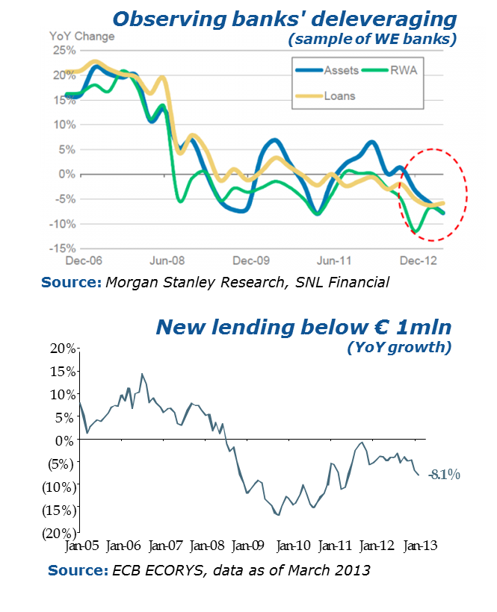
The SME Initiative Rationale
In the aftermath of the economic crisis, European banks have been forced to:
Deleverage their risky assets
Repair their balance sheets
Comply with tight regulatory requirements (Basel III, CRD IV),
which results in:
reduction in the volume of lending
market fragmentation
impaired money transmission to real economy
In this context, EU SMEs were particularly hit
ECB President Draghi, May 2013: "The key obstacle to a growth recovery seems to be the blocked credit channel to SMEs."

Slide 18
New SME Initiative: Option 1: SME Guarantee Instrument
Option 1 envisages uncapped portfolio guarantees and partial capital relief to banks building up new portfolios of SME loans. Up to 80% of the total portfolio will be covered on a loan by loan basis. ESIF will be used to cover the first loss piece. ESIF, COSME, Horizon 2020 and EIF will join to cover the mezzanine risk. Senior tranches will be guaranteed by EIB, while the originating bank must retain at least 20% of the risk on portfolio level.
Option 1 guarantee risk tranching
Newly originated loan portfolios
Guarantor
SME1
Senior tranche
European
Investment
Fund
Uncapped guarantee
on portfolio
level
Financial Institution 1
SME2
EIB Risk
EIF guarantee
SME3
Up to 80% guarantees on a loan-by-loan basis.
At least 20% risk retained by originator
Member State contribution
EIF, COSME, H2020 Risk
Mezzanine tranche
Max 7% of ERDF + EARDF
SME1
ESIF Risk
First loss piece
Financial Institution N
EIF guarantee
SME2

Slide 19
Option 1: SME Guarantee Facility
Provides uncapped portfolio guarantees and partial capital relief to banks building up new portfolios of loans, guarantees for loans [and leasing] to SMEs
Both direct guarantees and counter-guarantees
Description:
Originator (gradually) builds-up a portfolio of new SME loans
EIF issues uncapped portfolio guarantees and shares (hedges) the risk with various risk-takers:
ESIF: first-loss piece
ESIF and EU funds (COSME/Horizon 2020): second-loss tranches
EIF own funds: (upper) mezzanine tranche
EIB and national/regional development banks and private investors : senior tranche
Instrument can cover up to 80% of each loan included in the portfolio. Originator must retain at least 20% of each loan included in the guaranteed portfolio
Originator will have to demonstrate the transfer of benefit of the instrument to the SMEs in the form of acceptance of higher risk clients, reduction of collateral requirements and/or reduced pricing

Slide 20
SME Initiative
Benefits to Member State Markets
The SME Initiative
Does not require MS co-financing with national funds and thus saves national budget for other uses
Builds on an existing legal framework (COSME /Horizon 2020), allowing fast implementation and significant impact
Addresses some of the most important factors impeding credit growth by providing loan loss protection, capital relief and liquidity
Offers attractive pricing for FIs, with relevant benefits to be transferred to beneficiary SMEs
Imposes strict conditionality on new SME lending and “commitment fees” in case of non achievement of target volumes, thus ensuring originators’ commitment
Allows winding down the Funding Agreement in case of lack of market interest to re-use the ESIF budget for other SME-related projects
Allows complementarity with other national resources. Contribution to the Initiative capped at 7% of the Member State’s ESIF allocation (albeit with increased leverage for the funds contributed)

Slide 21
Thank you

