Slide 1
METAL
PRIZ
INNOVATE TRADITION WITH STYLE

Slide 2
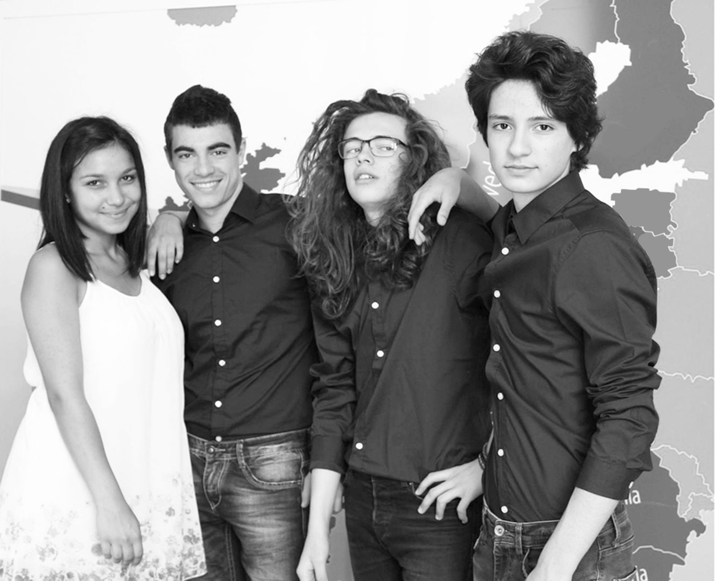
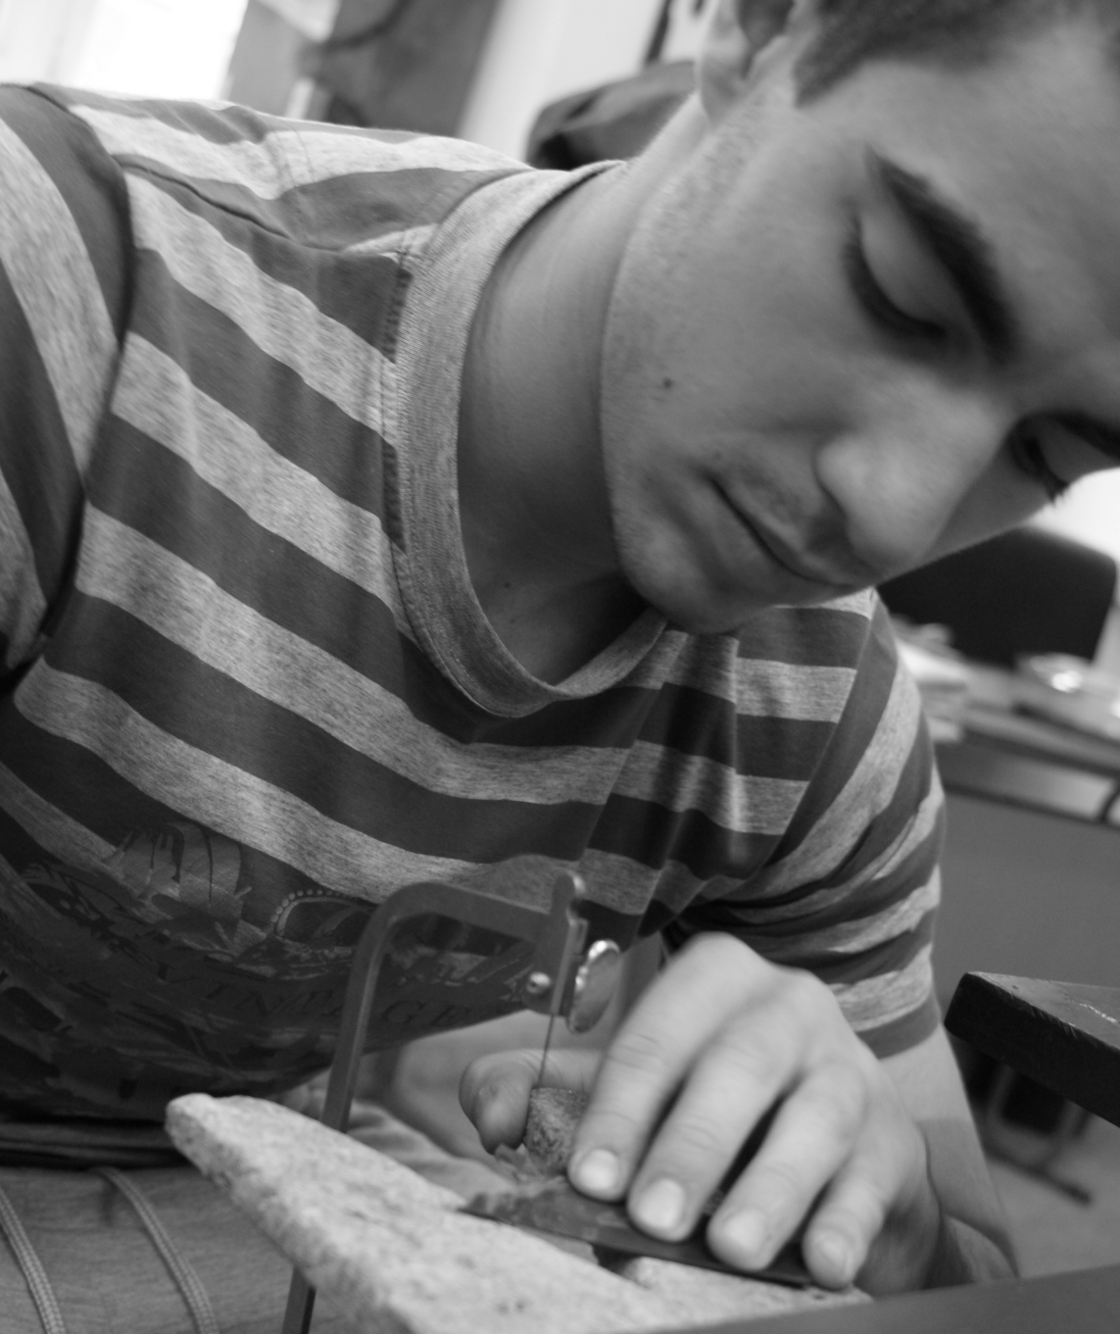
REVOLUTIONARY
TRADITIONAL

Slide 3
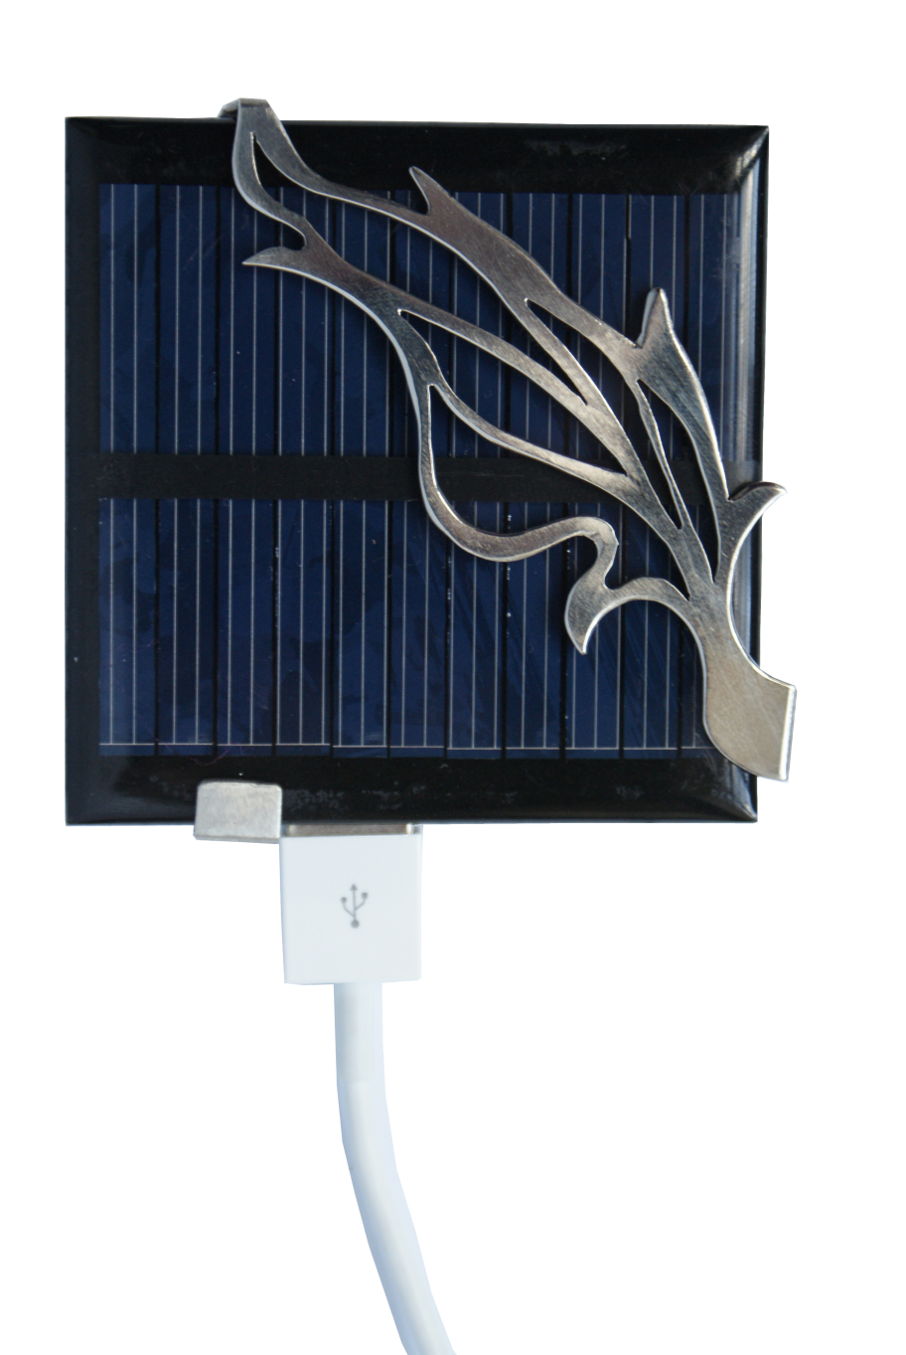
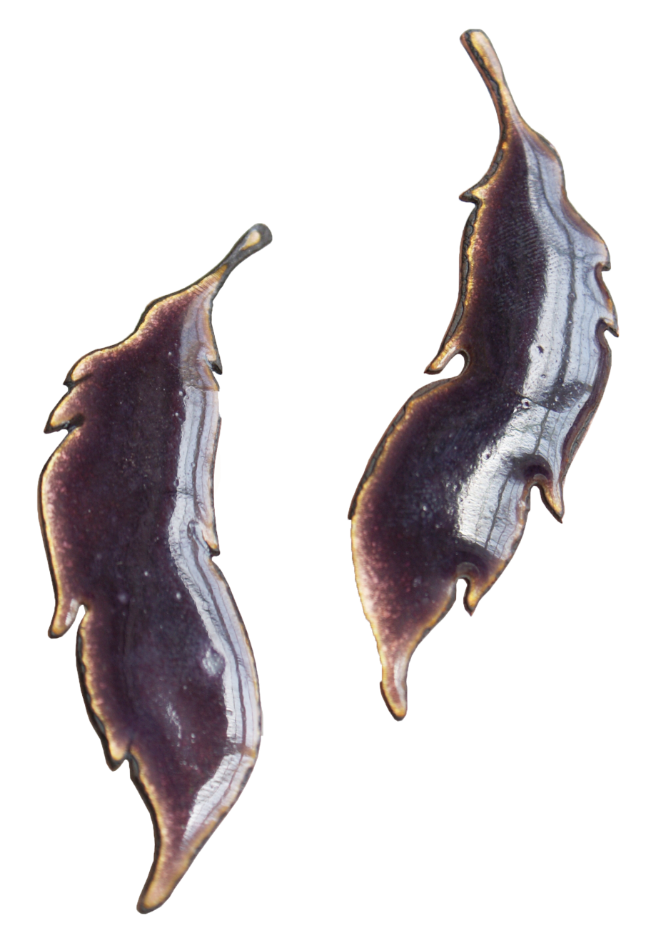
INNOVATIVE
CLASSIC

Slide 4
PRACTICAL
BEAUTIFUL
42
42,000
56.5%
€1,065
€1,500,000
€226
€250,000
2015
2020

Slide 5
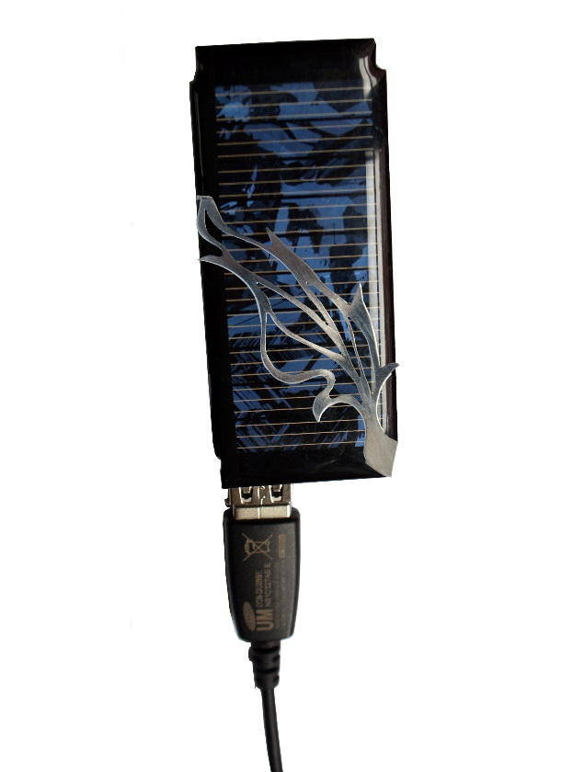
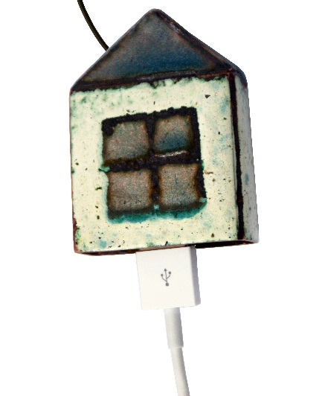
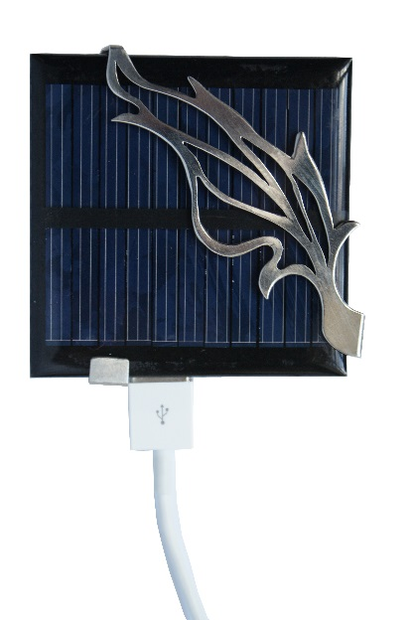
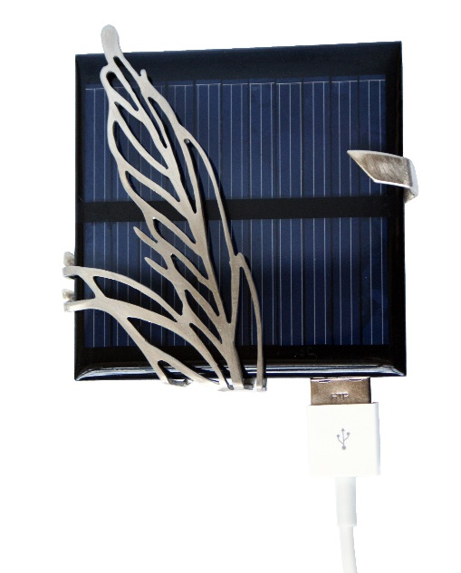
METAL
PRIZ
Innovative
Revolutionary
Practical
Classic
Traditional
Beautiful
Eco friendly

Slide 6
METAL
PRIZ
metalpriz.com
Facebook.com/metalpriz2014
Twitter.com/metalpriz

